Slide 1

Self Introduction
Aman Kumar Baghel
Course: B.Tech. in Computer Science & Engineering
College: Krishna Engineering College, Ghaziabad

Slide 2

Presentation:
“HEALTH GUARD: MULTIPLE DISEASE PREDICTION SYSTEM”
By : Aman Kumar Baghel

Slide 3

Multiple Diseases Prediction System Using M.L
Health Guard Application

Slide 4

Table Of Content
1 . Introduction
5. Data Flow Diagram
9. Conclusion
2.Role of M.L in Healthcare
6.View of Health Guard
10.Thank you
3.Why we need Health Guard?
7.Machine Learning Algorithm
4. Requirements Used
8. Future Planning

Slide 5
Introduction
The Multiple Disease Prediction System using Machine Learning is designed to predict diseases like diabetes, heart disease based on user-provided data. By analyzing patterns in health data, the system provides early detection of potential risks, enabling timely medical intervention.
This project addresses the need for accurate, scalable, and efficient diagnostic tools in healthcare, offering a user-friendly platform for rapid predictions. It demonstrates the potential of machine learning to enhance patient outcomes and support healthcare providers in making informed decisions.

Slide 6

Role of ML in Healthcare
Medical Imaging Analysis
Early Disease Detection
Personalized Treatment Plans
Drug Discovery and Development
Health Monitoring and Wearables
Reducing Medical Errors

Slide 7
Why we need Health Guard?
1. Early Detection of Diseases
Health Guard identifies potential health issues like diabetes, heart disease at an early stage, enabling timely medical intervention and improving outcomes.
2. Accessible Health Monitoring
The system provides a user-friendly platform for individuals to monitor their health regularly without needing frequent doctor visits, making health management more accessible.
3. Reducing Healthcare Burden
By predicting diseases early, Health Guard can reduce the strain on healthcare systems, allowing resources to be focused on those in immediate need of treatment.
4. Empowering Patients
The system empowers users with knowledge about their health, encouraging them to take control of their well-being and make informed lifestyle choices.
5. Cost-Effective Prevention
Early detection through Health Guard can help prevent the progression of diseases, potentially reducing the long-term costs of treatment and care.

Slide 8




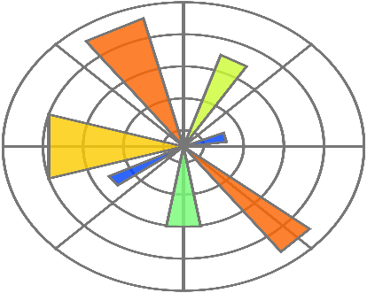




Technology and Library Used
Technology
Python Programming
Library
Scikit-Learn, Numpy, Pandas,
Matplotlib, Pickle, OS, Streamlit,
Editor
VS code or Jupyter Notebook

Slide 9
Data Flow Diagram
Diabetes
Disease
Data Preprocessing
Data Transformation
Heart
Disease
Parkinsons Disease
Machine Learning Algorithm
User Details
User Input
(Symptoms)
Diseases Prediction Model
Predicted Result

Slide 10
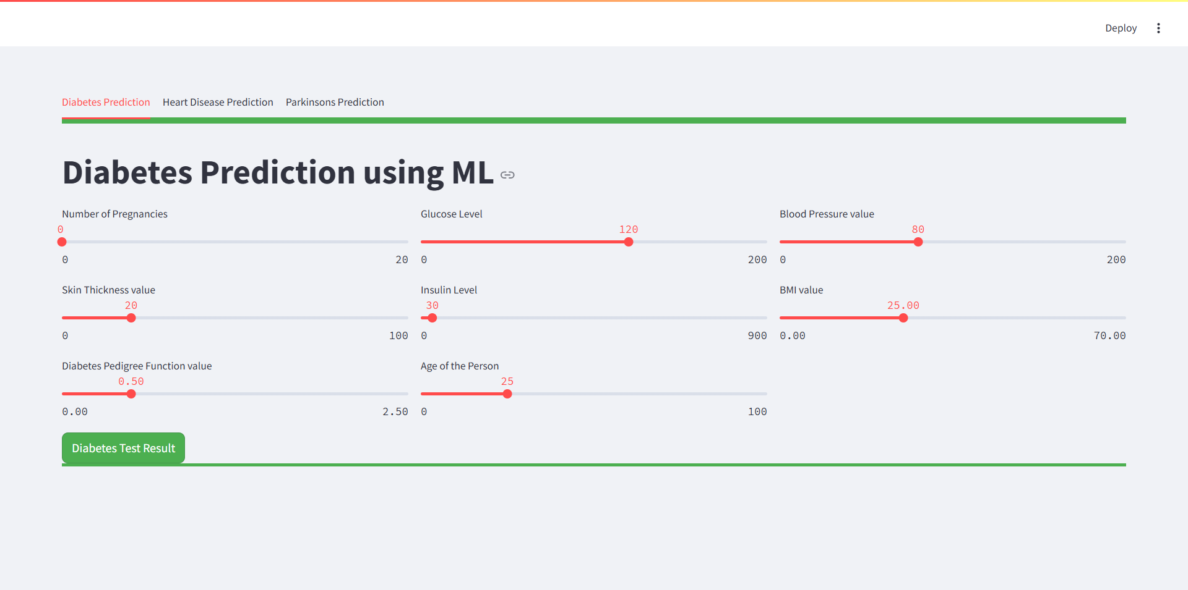
View of Health Guard
DIABETES PREDICTION
Notes:
DIABETES PREDICTION

Slide 11
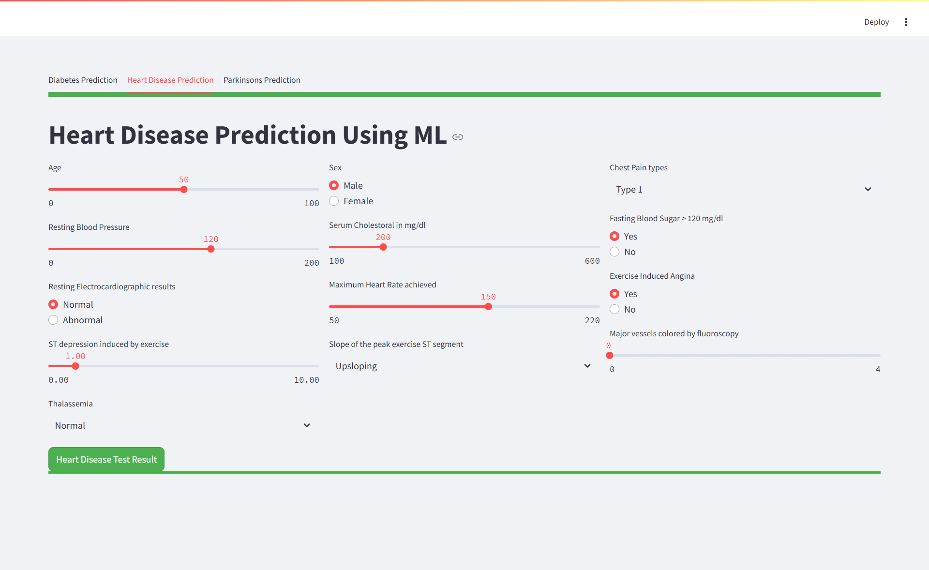
HEART DISEASE PREDICTION

Slide 12
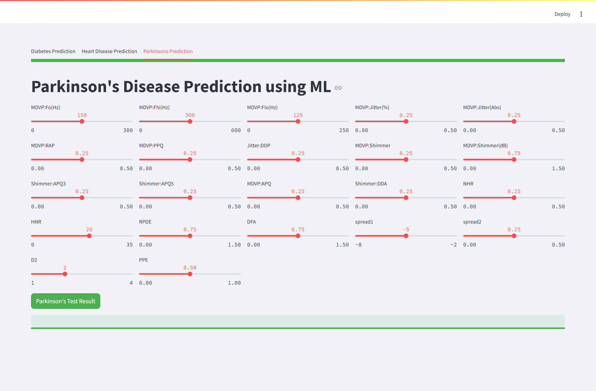
PARKINSONS PREDICTION
Notes:
PARKINSONS PREDICTION

Slide 13
Machine Learning Algorithm Used
In this Health Guard application (Multiple Disease Prediction System), I have included three disease prediction systems based on user input (symptoms):
Diabetes Prediction System
Heart Disease Prediction System
Diabetes Prediction system
A diabetes prediction system using SVM classifies patients as diabetic or non-diabetic by finding the optimal hyperplane that separates these classes based on health metrics(e.g., glucose levels, BMI, age). The model is trained on patient data and then predicts diabetes risk for new inputs. SVM is effective for accurate classification in high-dimensional data.

Slide 14

2)Heart Disease Prediction System
The Heart Disease Prediction System uses a Logistic Regression model to analyze patient data, identifying the probability of heart disease based on factors like age, blood pressure, and cholesterol levels. The model is trained to classify patients into risk categories, enabling early detection and intervention. This statistical approach is effective for binary classification problems like predicting the presence or absence of heart disease.
3) Parkinson's Disease Prediction System
The Parkinson's Disease Prediction System uses a Support Vector Machine (SVM) model to classify patient data and predict the likelihood of Parkinson's disease based on various clinical features. This approach ensures accurate identification of the disease by finding the optimal decision boundary between healthy and affected individuals.

Slide 15
SVM (Support Vector Machine)
Support Vector Machine or SVM is one of the most popular Supervised Learning algorithms, which is used for Classification as well as Regression problems. However, primarily, it is used for Classification problems in Machine Learning.
The goal of the SVM algorithm is to create the best line or decision boundary that can segregate
n-dimensional space into classes so that we can easily put the new data point in the correct category in the future. This best decision boundary is called a hyperplane.
SVM chooses the extreme points/vectors that help in creating the hyperplane. These extreme cases are called as support vectors, and hence algorithm is termed as Support Vector Machine.
There are two types of SVM:
1) Linear SVM 2) Non-Linear SVM

Slide 16
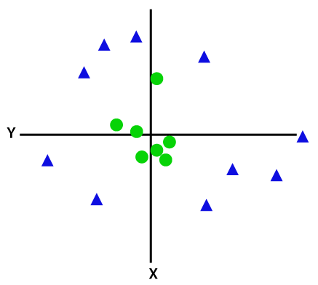
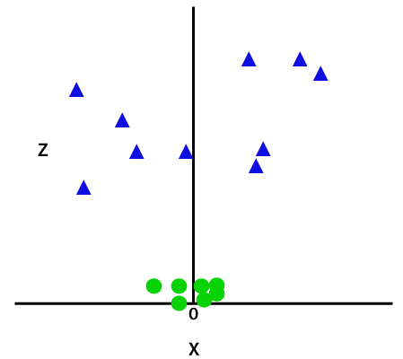

For Non-Linear dataset we will add a third dimension z,
where; z=x² +y²
Linear SVM
Non-Linear SVM

Slide 17
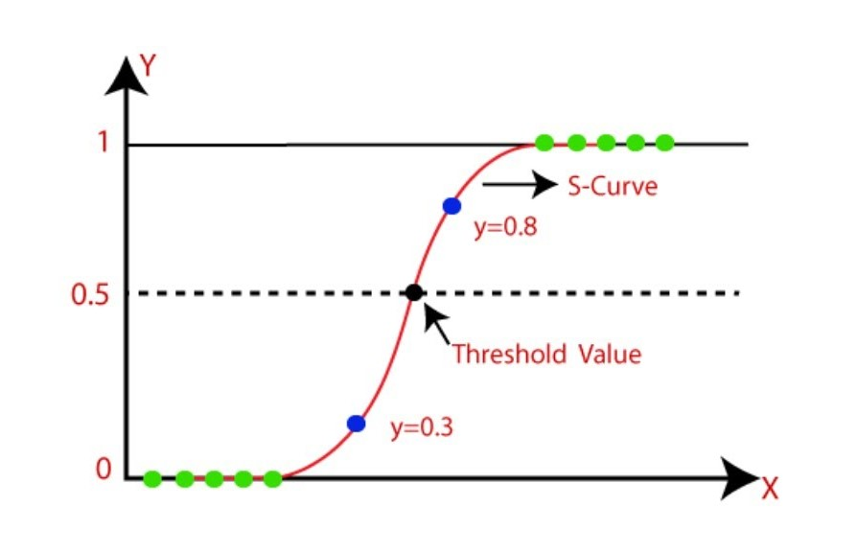
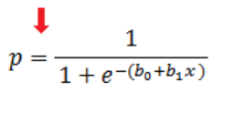

Logistic Regression
Logistic regression is a supervised machine learning algorithm that accomplishes binary classification tasks by predicting the probability of an outcome, event, or observation. The model delivers a binary or dichotomous outcome limited to two possible outcomes: yes/no, 0/1, or true/false.
Y
Y
OR
bo= Intersecpt
b1= Coefficient
-beta = Coefficient

Slide 18
Future Planning
In future we will try to implement this system which prescribe medicine from the past history.
We will arrange the video conferencing for talking to doctors at any time of the day, wherever we are.
Conclusion
1. Accurate disease prediction using machine learning models.
2. Facilitates early detection and timely intervention.
3. Provides a comprehensive, multi-disease diagnostic tool.

Slide 19


